Slide 1
AR BASED SMART EDUCATION IN ANDROID PLATFORM WITH UNITY
Batch A9
Aishwarya C (211417104006)
Devika Vinod (211417104049)
Guide
Mrs. M. S. Vinmathi
(Associate Professor)

Slide 2
INTRODUCTION
Augmented reality is a fast and an emerging research field of computer science and technology
AR brings digital to life by interacting with the environment in real time
By introducing Augmented reality into the education system, teachers can convey their knowledge more preciously and in a very attractive manner. Students will understand more easily if this technology is introduced to them.
In this application the topics can be observed in 3D graphical image and video format replacing the traditional 2D view.
This deployment is done for creating a classroom environment for all the students by using augmented reality which initiates more interaction to students as well as they can see all practical implementation of their subject through a virtual mode which reduces the stress of students in understanding a subject

Slide 3
Literature Survey
TITLE | YEAR | AUTHOR | TECHNIQUE | DRAWBACKS
A Smart Phone Integrated Smart Classsroom | 2016 | Mahesh.G Jayahari K.R | Wi Fi router would be connected to the mobile phone and it will be connected to a server to control the attendance of the students and takes face recognition. Internet would not be needed.The Wi Fi would be confined only inside the classroom. | Each student requires smart phone
Using Mobile Devices & Social Media in Supporting Engineering Education | 2014 | Khan M M Jeffrey C L Chiang | Investigates how students at university use smart phones with respect to engagement and interaction in various learning activities. Studies how students engage with learning tasks and what social interactions occur when they are trying to achieve their academic goals. | It includes few tools and everyone would require a smart mobile phones.

Slide 4
Literature Survey
TITLE | YEAR | AUTHOR | TECHNIQUE | DRAWBACKS
Smart learning Environment | 2019 | Xinxin Deng Rong Zhang | IOT is used here as it completely studies the matching degree, satisfaction degree, advantages and disadvantages between the general multimedia classrooms and the smart learning classrooms. | No interaction with the smart class environment
Use of Smart Glasses in Education | 2018 | Nallapaneni Manoj Kumar P. Ranjith Krishna | Applications include the augmented reality, documentation of lecture, on-site report preparation, recording lectures as videos, capturing essential points as images, telementoring, trainee’s evaluation, understanding the listener's experience and nature, student concentration evaluation. | Implementation of smart glass services would be difficult as they involve the complex network.

Slide 5
Literature Study
TITLE | YEAR | AUTHOR | TECHNIQUE | DRAWBACK
A Novel Model Of Smart Education For The Development Of Smart University System | 2020 | Gambo Yusufu Nachandiya Nathan | Smart education IS “a student- centric intelligent learning environment enriched with digital learning resources to provide smart pedagogies that support smart learners’ personalised learning experiences anywhere at any time using smart portable device and linked across educational institution or training workforce through the advancement and superiority of smart and wireless technologies. | Investment in smart technologies and digital devices comes with cost on the educational institution. New security and safeguards policies needed to be developed.

Slide 6
Literature Study
TITLE | YEAR | AUTHOR | TECHNIQUE | DRAWBACK
Smart Augmented Reality Glasses in Cybersecurity and Forensic Education | 2016 | Nikitha Kommera Faisal Kaleem Syed Mubashir Shah Harooni | Presents an augmented reality technology based teaching and learning approach to enhance cybersecurity education by using the leading-edge technology that gives rise to new ways to motivate and educate students about cybersecurity and forensics field; the innovative use of cutting-edge technology to develop new interactive courses and modules in cybersecurity and forensics will attract and retain students with STEM focus. | IOC,An important tool for forensic education is still not implemented.

Slide 7
Literature Study
TITLE | YEAR | AUTHOR | TECHNIQUE | DRAWBACK
Virtual Smart Classroom | 2017 | Noawanti Songkram | The application, ‘VSLI’ standing for Virtual Smart Learning and Innovation System, is used. The functions of this application consist of chat logs, webboards, hall of fame, learners’ tasks, open resources, and learners’ data collection during the lesson allowing the teacher to access the data and use it for assessment | Implementation is costlier
Intelligent classroom information system | 2020 | Zijuan Zhou | Mobile application based. It uses a set of wireless monitoring and terminal mobile client of the system which can transmit the monitoring data for clients for enquiry and thereby resolve the query. | Suitable for distance learning not for classroom

Slide 8
Literature Study
TITLE | YEAR | AUTHOR | TECHNIQUE | DRAWBACK
Using Convolutional Neural Networks for Smart Classroom Observation | 2020 | Muhammed S.Khan | Convolution Neural Network (CNN) for smartclass.It used class observation audio data to classify classroom activities into those based on the Stallings Classroom Snapshot where a classroom observer takes a 360 view of a classroom every 5 minutes or so for a 50-minute class for 15 seconds and then records his observations using a structured coding sheet. | Real time implementation is difficult

Slide 9
PROBLEM STATEMENT
It is a well-known fact that our current education system lags behind in certain aspects.
We still follow the traditional blackboard method of teaching which fails to provide every student with proper guidance.
No student is the same.Some students grasp a concept very easily whereas some take time. Some understand better when they are provided with better explanation with audio and video.
Modern methods of teaching have been implemented in a fewschools like the use of smartboard and stylus. But even these fail in certain aspects.
Taking one step further is our “AR based Education Application” allowing users to view a 3D rendered model - a virtual resemblance of the physical furniture without any interruption of the markers - which can be viewed and configured in real time using our Augmented reality application.
Our application allows a 2D object to be visualized in a 3D format thus providing a detailed explanation of each and every layer of that image which otherwise would have been inaccessible.

Slide 10
Technology Stack
Language | C#, Java
OPERATING SYSTEM | - Android Studio and SDK tools. - JAVA development kit. - Android SDK tools if testing on an android device
TOOLS | Unity 3D(2020.1.1) a game engine is used as the main development environment. Vuforia Cloud used to Perform all aspects of the AR from the image tracking to the image registration.
User Application

Slide 11
System Architecture
Augmented
objects
Vuforia
Input Frames
Cloud combined view
Real time Objects
Real time and Augmented
view

Slide 12
System Design
UML DIAGRAM
Image Dataset Collection
Data Preprocessing
Feature Extraction
Classify The Dataset
Text and Object Detection with Audio Output
Result

Slide 13
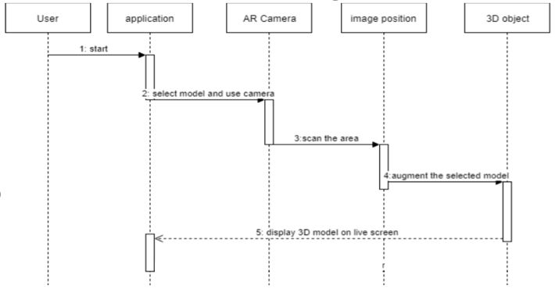
SEQUENCE DIAGRAM

Slide 14
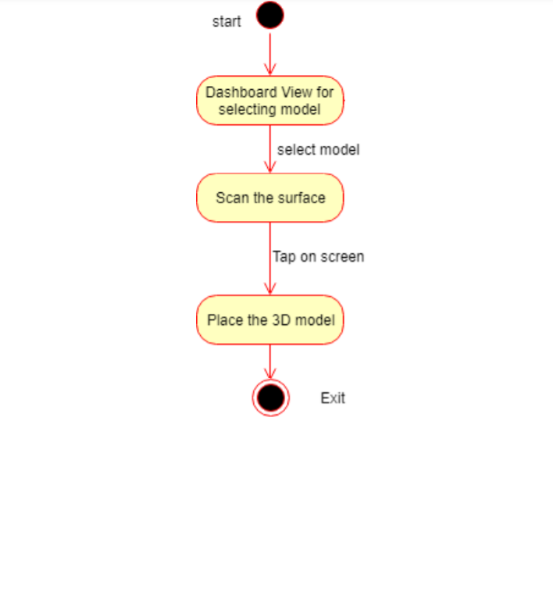
ACTIVITY DIAGRAM

Slide 15
MODULE DESCRIPTION
The application implementation consists of four modules.
• Creating Augmented Reality Objects.
• Developing Scenes for User Interface.
• Place the Object on the Surface Area.
• Development of .APK

Slide 16
MODULE DESCRIPTION
Creating Augmented Reality Objects:
First, we have to open the unity3D project.
Then we need to select the GameObject menu in the menu bar. The GameObject Menu has more objects to create a game.
From there we can select a 3D object and pick the shape options given according to our requirement.
We can select the rotation tool which helps to rotate our plane object. It also rotates all the objects in our scene.
We can create the assets by using the hierarchy view which helps us to combine various shapes within the unity.
There is a pro builder in Unity which allows us to edit our shapes helping us to obtain our 3D furniture objects.

Slide 17
MODULE DESCRIPTION
Developing Scenes for User Interface
In this module we create scenes for every slide of application using Unity 3D.
The main interface contains 3D model, buttons that helps to move to next model, to scan the surface area of educational material and place the equivalent 3D object over there.
In order to implement these functions, we make the scene display to ratio of Android display and add the buttons to the scene that helps in moving to next scene.
Later we use the 3D model developed in Unity 3D and functionalities like rotating the 3D models will be displayed using C# code for that object and add functionalities to move to next scene.

Slide 18
MODULE DESCRIPTION
Place the Virtual Object on the Surface Area
For this project Android studio is used with the Vuforia package.
Vuforia packages is used because it offers 3D model demonstrations, to create applications for customers to personalize their products and gives a robust AR experience with the vision technology.
We upload our target image in the Vuforia cloud, it renders the features of the target image and stores it such that when we scan the environment it identifies the target image.
After the identification, our 3D object gets placed over the target image. Target image acts as a position indicator such that the 3D image gets fixed wherever we place our target image.

Slide 19
MODULE DESCRIPTION
Development of .APK
With the help of Java (SDK) and Android Studio, we can be able to generate android file that executed in android mobile with version 8.0(Oreo) and above.
This application when operated will automatically enable us to view the respective 3D models of the material we require, thus, illustrating better method of explanation to the students.

Slide 20
TESTING
SR NO | ACTION | EXPECTED RESULT | ACTUAL RESULT | FINAL RESULT
1. | Add image target in the Hierarchy | Image target added to the hierarchy. | Image target added to the hierarchy. | Pass
2. | Press play button to see the animation | Animation can be seen. | Animation can be seen. | Pass
3. | Opening software to make a new AR scene | Software was able to be opened. | Software was able to be opened. | Pass
4. | Changing scene from one level to another level | Scenes could be changed. | Scenes could be changed. | Pass
5. | Press the button to play the object | Object was played. | Object was played | Pass

Slide 21
SR NO | ACTION | EXPECTED RESULT | ACTUAL RESULT | Final result
6. | Tap to place the 3D object | 3D object is placed. | 3D object is placed. | Pass
7. | 3D object shows up only when virtual button is clicked | 3D object when clicked successful | 3D object when clicked successful | Pass
8. | Information button is visible when clicked on image | Info part Visible | Info part visible | Pass
9. | Building app. | App has been built. | App has been built. | Pass
10. | Open the application and target the 3D model | Application runs successfully. | Application runs successfully. | Pass

Slide 22
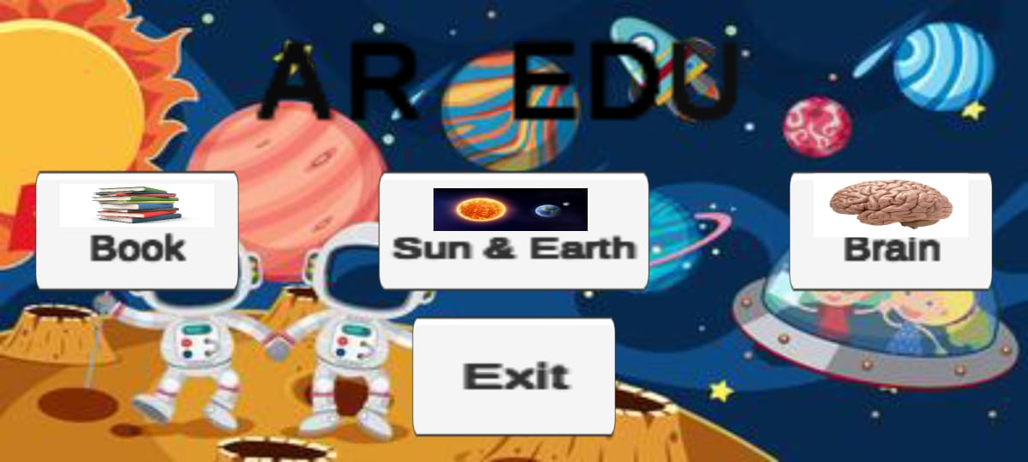
Screenshots

Slide 23
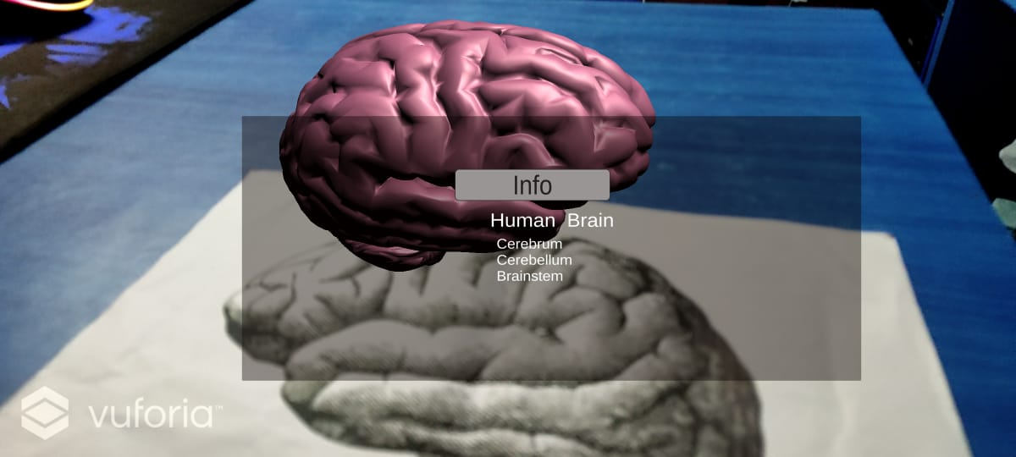
Screenshots

Slide 24
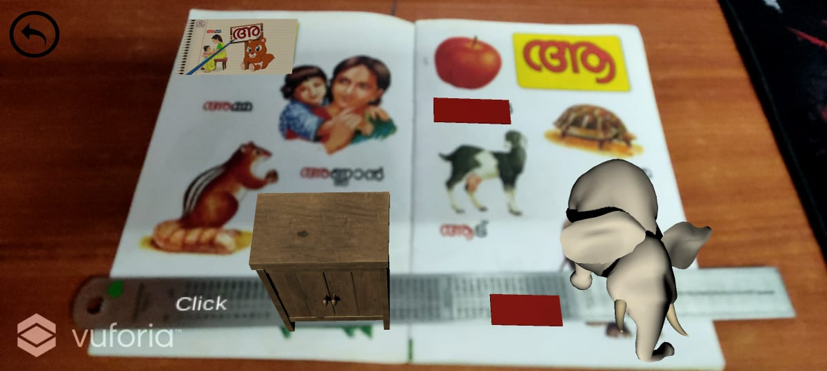
Screenshots

Slide 25
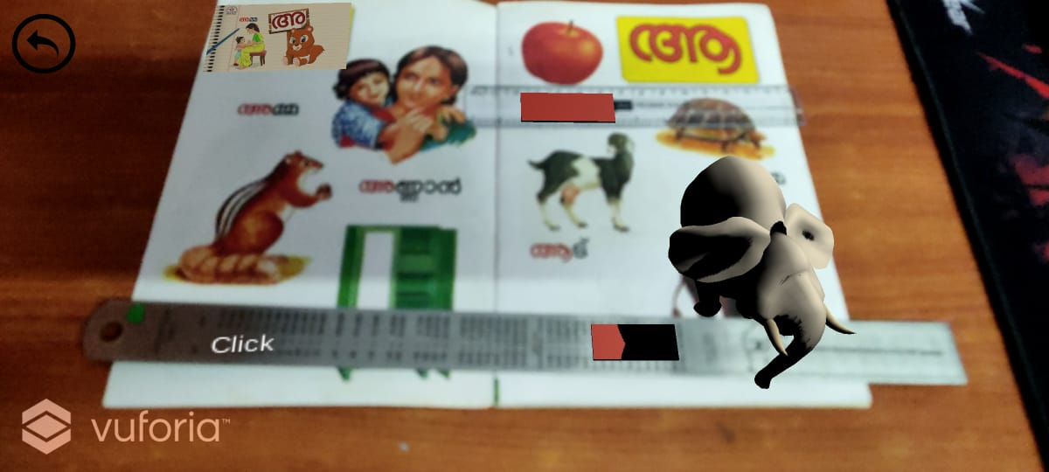
Screenshots

Slide 26
CONCLUSION
The main objective of this “AUGMENTED REALITY BASED APPLICATION FOR EDUCATION” is to analyse the use of augmented reality in the field of education.
This system will help us to enhance our current traditional education system which mostly makes use of blackboards and textbooks.
This application will allow the students to get better understanding of certain topics as it will display 3D models live and thus provides a detailed view and explanation of the topics.

Slide 27
REFERENCES
W. Lu, J. Han and L. Geng, "Intelligent Classroom Information System," 2019 International Conference on Smart Grid and Electrical Automation (ICSGEA), Xiangtan, China, 2019, pp. 259-262, doi: 10.1109/ICSGEA.2019.00067.
M. S. Khan and I. Zualkernan, "Using Convolutional Neural Networks for Smart Classroom Observation," 2020 International Conference on Artificial Intelligence in Information and Communication (ICAIIC), Fukuoka, Japan, 2020, pp. 608-612, doi: 10.1109/ICAIIC48513.2020.9065260.
X. Deng and R. Zhang, "Smart Learning Environment: A Case on the Construction of Smart Classrooms in Colleges and Universities in Guangzhou," 2019 International Symposium on Educational Technology (ISET), Hradec Kralove, Czech Republic, 2019, pp. 262-264, doi: 10.1109/ISET.2019.00062.
M. G., J. K.R. and K. Bijlani, "A Smart Phone Integrated Smart Classroom," 2016 10th International Conference on Next Generation Mobile Applications, Security and Technologies (NGMAST), Cardiff, UK, 2016, pp. 88-93, doi: 10.1109/NGMAST.2016.31.
N. Songkram, "Virtual smart classroom to enhance 21st century skills in learning and innovation for higher education learners," 2017 Tenth International Conference on Mobile Computing and Ubiquitous Network (ICMU), Toyama, Japan, 2017, pp. 1-4, doi: 10.23919/ICMU.2017.8330109.

Slide 28
REFERENCES
6. Nallapaneni Manoj Kumar , P. Ranjith Krishna, Pavan Kumar Pagadala, N. M. Saravana Kumar “Use of Smart Glasses in Education” 2018 Proceedings of the Second International conference on I-SMAC (IoT in Social, Mobile, Analytics and Cloud) (I-SMAC 2018,doi: 10.1109/I-SMAC.2018.8653666
7. Khan M M H, Jeffrey C L Chiang “Using Mobile Devices & Social Media in Supporting Engineering Education, 2014 IEEE Global Engineering Education Conference (EDUCON), Istanbul, Turkey,doi: 10.1109/EDUCON.2014.6826241
8. Gambo Yusufu, Nachandiya Nathan ,” A Novel Model Of Smart Education For The Development Of Smart University System” 2020 International Conference in Mathematics, Computer Engineering and Computer Science (ICMCECS), Ayobo,Nigeria,doi: 10.1109/ICMCECS47690.2020.240912
9. Nikitha Kommera , Faisal Kaleem , Syed Mubashir Shah Harooni ,” Smart Augmented Reality Glasses in Cybersecurity and Forensic Education”,2016 IEEE Conference on Intelligence and Security Informatics (ISI), Tucson, AZ, USA,doi:10.1109/ISI.2016.7745489

